Slide 1

SELECTING OPTIMAL CRICKET SQUAD USING DATA ANALYSIS
Shyam Kawale – shyam.kawale18@vit.edu
Bhargav Pawar – bhrgav.pawar18@vit.edu
Nishant Bhat – nishant.bhat18@vit.edu
Abhijit Gawai – abhijit.gawai18@gmail.com

Slide 2
AIM
Problem Statement: On Performance Measurement of Cricketers and Selecting an Optimum Balanced Team
A cricket squad that participates in a tournament generally comprises of fifteen players. A balanced squad contains players having different expertise like batting, bowling, wicket keeping, etc. Keeping in view the cricketing requirements, selecting an optimal squad is a difficult decision-making problem.
Team selection for international sports competitions requires predicting performance of individual athletes.
We explore the use of data science to rate players and select specific players for a competition.
We employ various algorithms to predict each cricketer’s performance in the future based upon the number of parameters we are considering.
Currently we have collected data from the IPL 2008 to 2018 and we process this data to fetch the necessary details required.

Slide 3
Objective
Data science is already creating a huge impact on various industries.
Now, these technologies can be used to analyze the game of cricket.
We are using a combination of statistical metrics — luck index, forecaster and smart statistics — that use data science contextualize every event in a game.
Of course its not going to be able to predict everything because the cricketers are humans and not machines but these algorithms rationalize and calculate lucky events so that the entire tournament can be compared in a ‘apples-to-apples’ fashion with matches in different situations

Slide 4
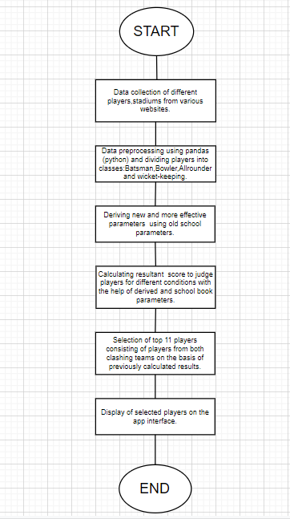
Algorithm

Slide 5
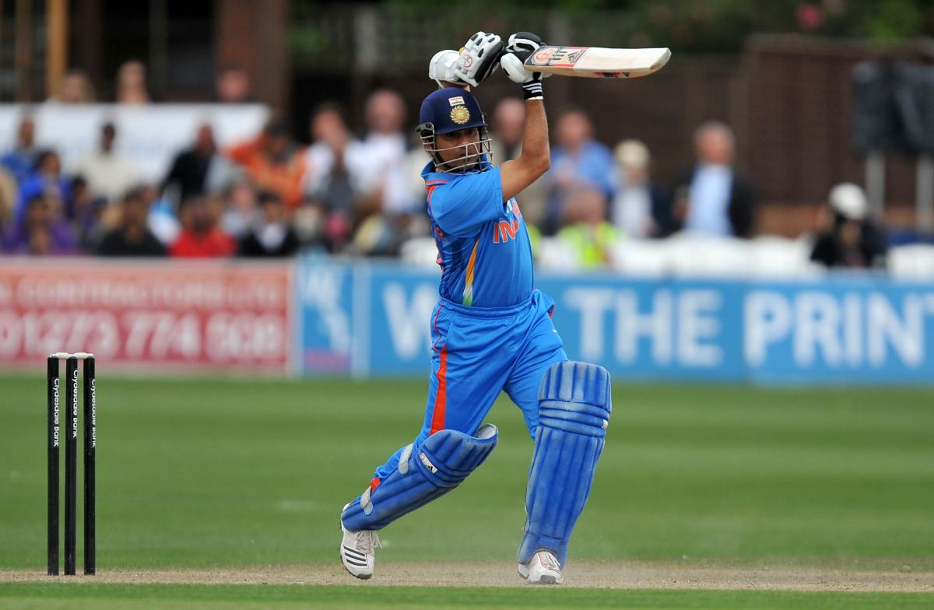
Batting Parameters Used:
Runs
Consistency
Average
Strike Rate
No of 100s and 50s
Hard hitting ability: (4s + 6s) /Balls Played
Finisher: (Not out innings/Total innings)
Running between wickets: (Total runs-(4s + 6s))/ (Total Balls played – Boundaries)
Successful chases
Time on Pitch

Slide 6
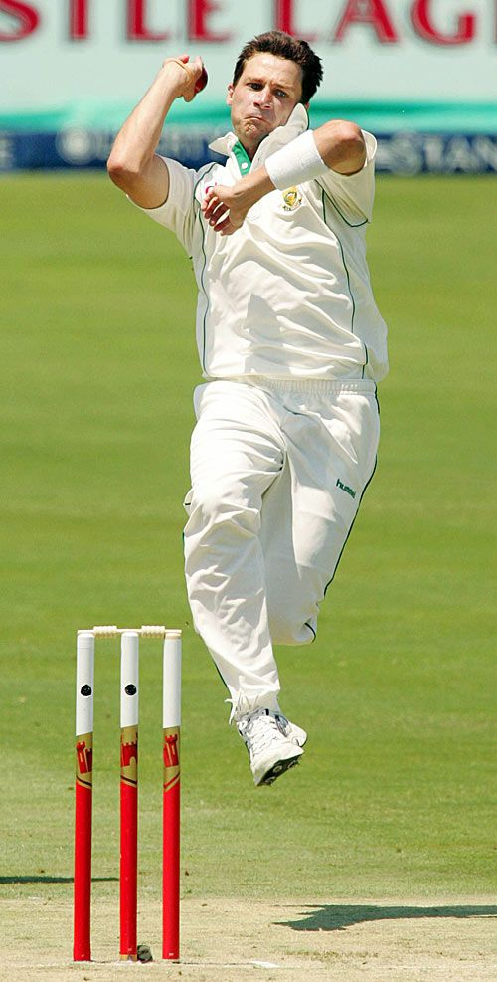
Bowling Parameters Used:
Wickets
Average
Economy rate
Dot pressure Index
4 wicket hauls
Strike rate
Pitch Impacts
Contribution to the result
Opposition Impact

Slide 7

Resultant Formula and Weight Calculation.
Batting Calculation:
Res_ben= (30/550)*Res_runs+(65/550)*Res_avg")+(100/550)*Res_SR+(50/550)*Res_big_score+(110/550)*Hard_Hitting_Ability+(80/550)*Finisher+
(30/550)*Running_between_wickets+(35/550)+Consistency+(15/550)*Time on pitch+(35/550)*Power Factor
2. Bowling Calculation:
Res_chen=(90/550)*Res_econ+(95/550)*Res_avg+(80/550)*Res_sr+(95/550)*Res_wkts+(20/550)*Res_wkhaul+
(80/550)*Impatchen+(70/550)*Res_db+(20/550)*Res_exp
3. Wicket Keeping calculation:
Res_mum=0.6*Bat_mum+0.4*Res_wktk
4. All rounder calculation:
ARes_ben=0.6*RES_BEN+0.4*BRES_BEN
ARes_chen=0.4*RES_CHE+0.6*BRES_CHE
ARes_mum=(RES_MUM+BRES_MUM)/2

Slide 8
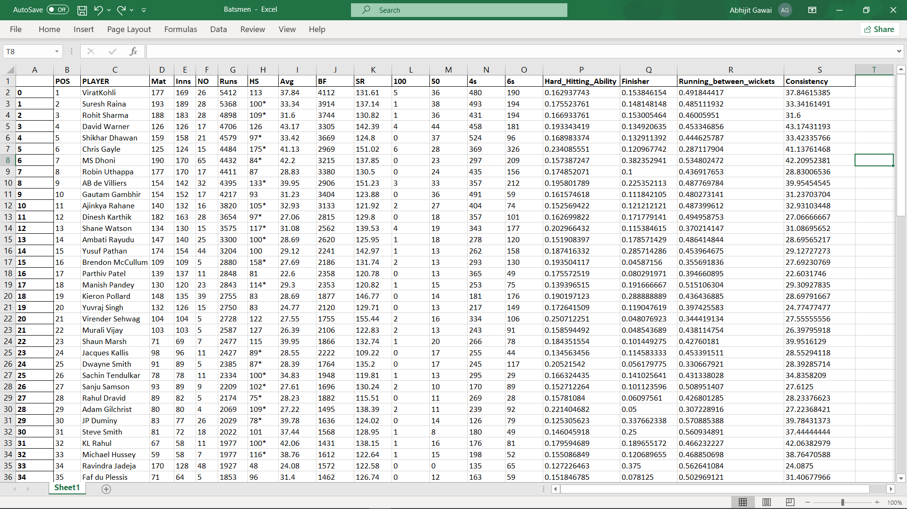
Database
Dataset is obtained from Kaggle.com
This is dataset for batting purpose

Slide 9
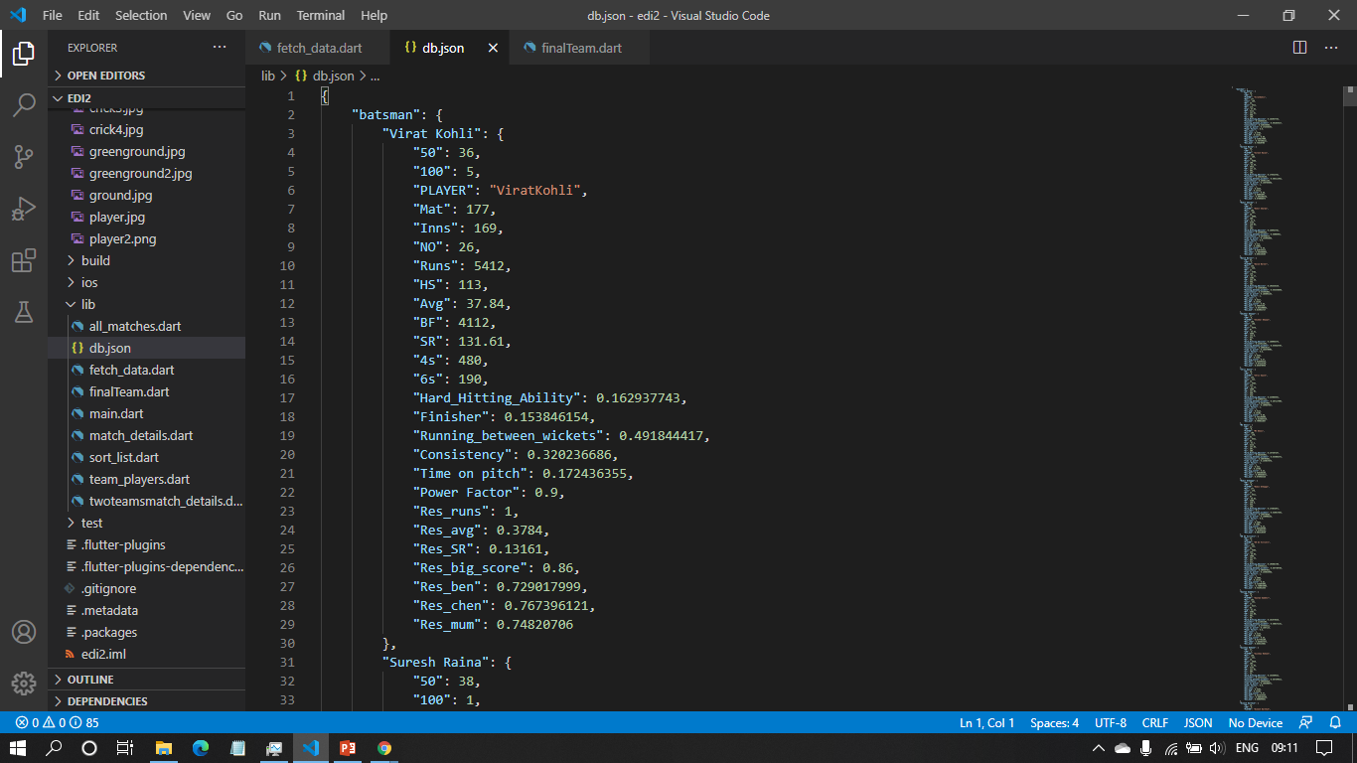
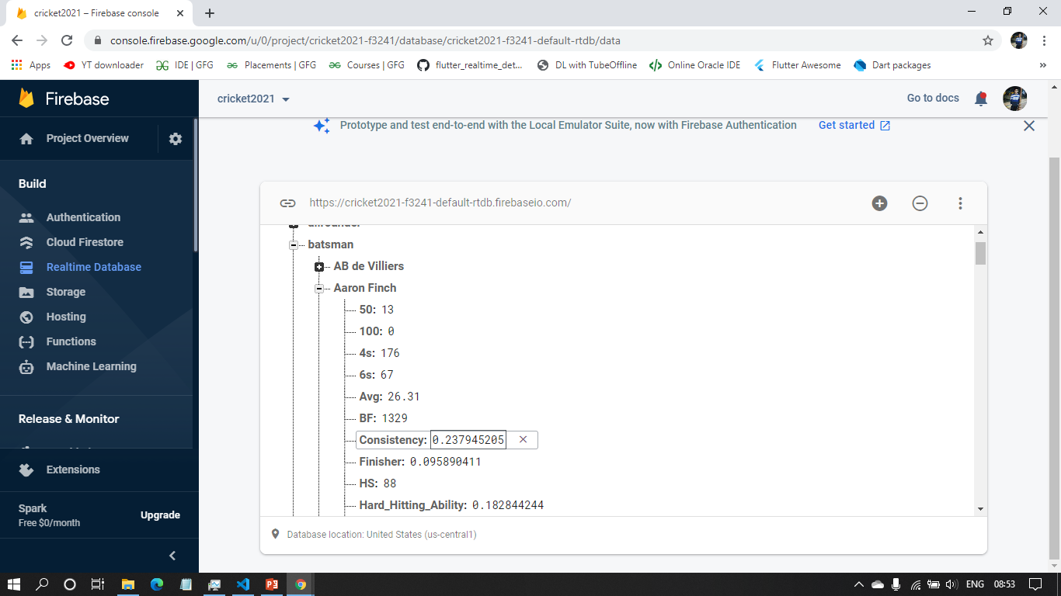
Database
Fig A. Json form of Excel Sheet
Fig B. Firebase realtime DB

Slide 10
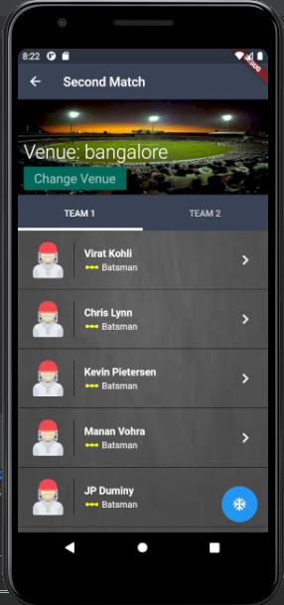
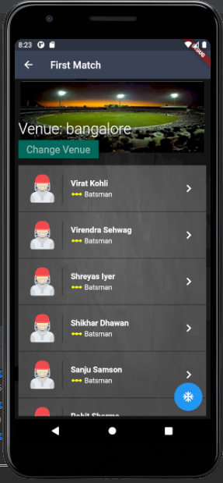
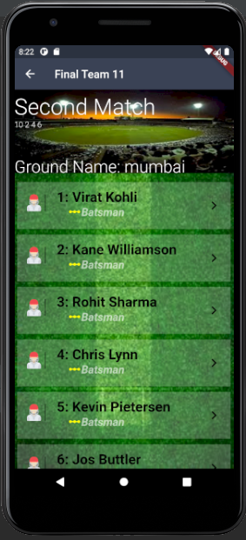

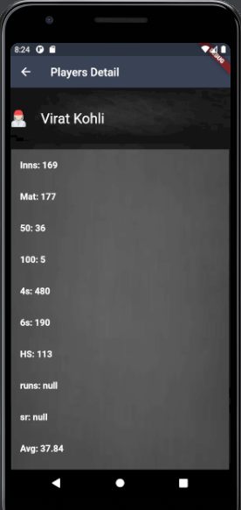
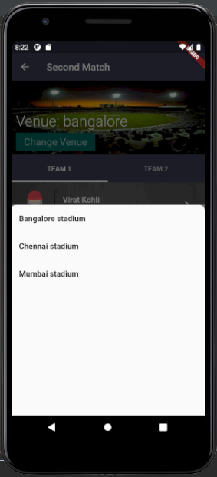
Flow of app:
Screen. B
Screen. C
Screen. A
Screen. D
Screen. E
Screen. F

Slide 11
Conclusion
Selecting an optimal starting team is a difficult task.
Many Parameters are involved.
Parameters of Individual player are considered.
Parameters of Individual player according to pitch are also considered.
Automating process saves time.
Winning formula considers both strengths and shortcomings of player
Similar mechanism can be applied to while playing on dream 11

Slide 12

Future Scope of Project
Data Science is being used to improve cricket strategy.
We can use similar mechanism in other cricket format.
We can also use mechanism in other formats.
It can also be used to help accurately predict match results.
It can be used to select a squad of players that suit that particular opposition, weather conditions and the state of pitch taking into consideration how they fared in the previous matches.
A similar such program can also be used in popular fantasy games like DREAM 11 who are the current sponsors of the IPL season.

Slide 13
References
[1] Kamble, A., Rao, R., Kale, A., and Samant, S. (2011), Selection of cricket players using analytical hierarchy process, International Journal of Sports Science and Engineering, 5(4), 207-212.
[2] Barr, G. D. I. and Kantor, B. S. (2004), A criterion for comparing and selecting batsmen in limited overs cricket, Journal of the Operational Research Society, 55(12), 1266-1274.
[3] Gerber, H. and Sharp, G. D. (2006), Selected a limited overs format of cricket squad. They choose using an integer programming model, South African Journal for Research in Sport, Physical Education and Recreation, 28(2), 81-90.
[4] Lourens, M. (2009), Integer optimization for the selection of a Twenty20 cricket team, Nelson Mandela Metropolitan University, Faculty of Science, South Africa: Unpublished Master of Science Dissertation in Mathematical Statistics
[5] Bretteny, W. (2010), Integer optimization for the selection of a fantasy league cricket team, South Africa: M.Sc. Dissertation, Nelson Mandela Metropolitan University.
[6] Lemmer, H. H. (2002), The combined bowling rate was taken as a measure of bowling performance in cricket, The South African Journal for Research in Sport, Physical Education and Recreation, 24(2), 37-44.

